Slide 1
Tips para mejorar las condiciones laborales en la región durante la crisis de 2023
SG Talks2Code
August 2023

Slide 2



R&D Director at Kata Software, more than 10 years of experience. Leader, developer, team builder, coach. Passionate about videogames, AI, testing, and tech in general.
/streetwizard17
@streetwizard17

Slide 3

Universal Platform for financial services

Slide 4


Origination
Mobile
Office
Software
As a
Service
Virtual
Asistant
Validación
de Identidad
Omnichannel
Customizable
Kata Engine
CLOUD PLATFORM
for the Digital Banking era
Orchestrator
Multiproduct
Digital
Onboarding
Validación
De Documentos
Compliance
Integration
Connectivity
Collaboration
Firma digital
Propietario
Aliado

Slide 5
¿What do we want?

Slide 6

OECD - Quality of life: What matters to you?
https://youtu.be/yYNjXRVFnTc?si=hrwgAxIOyiy3E0vM

Slide 7
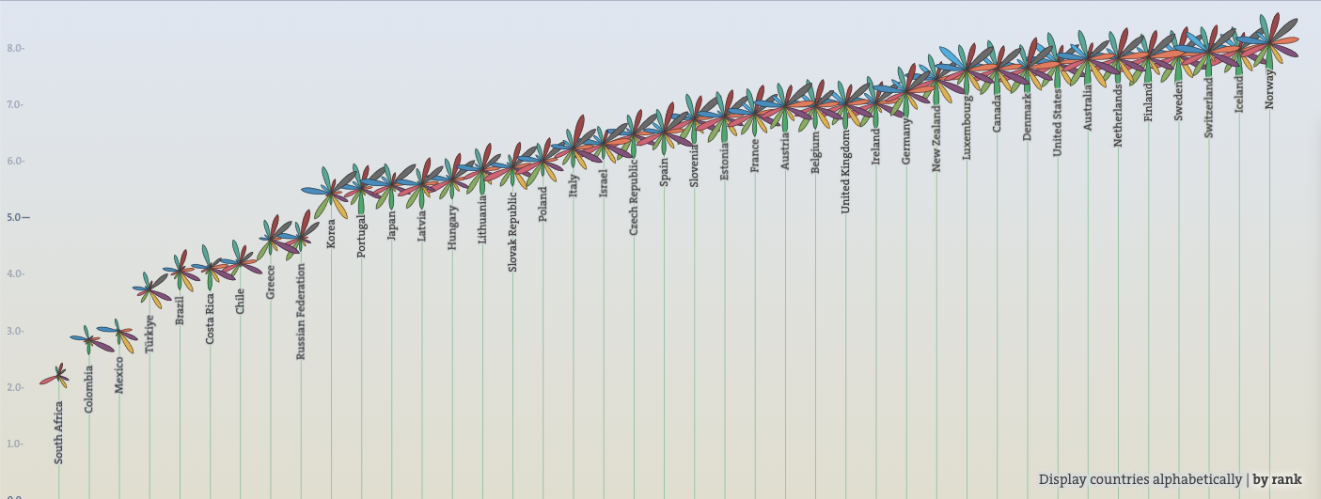
OCDE Better Life Index - https://www.oecdbetterlifeindex.org/

Slide 8
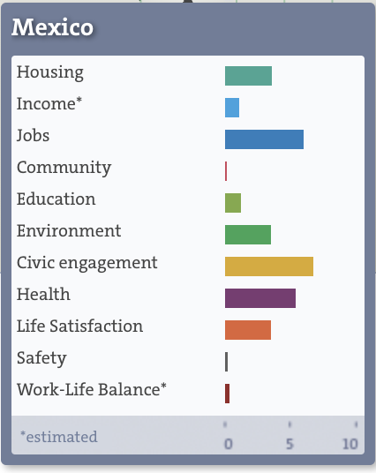
OCDE Better Life Index - https://www.oecdbetterlifeindex.org/

Slide 9

¿Are we in crisis?

Slide 10
Problem #1

Slide 11
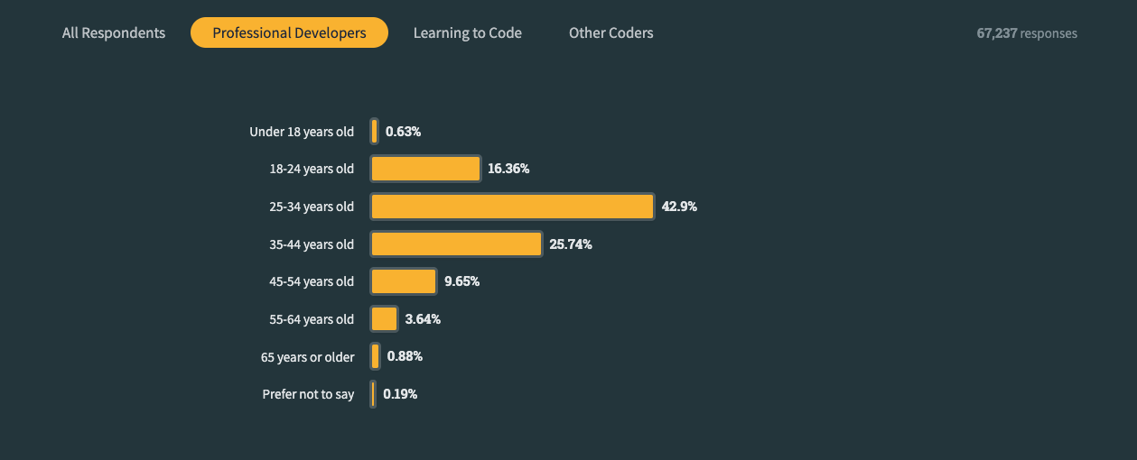
43% of Professional Developers are 25-34 years old born between 1989 - 1998
Stack Overflow Developer Survey
https://survey.stackoverflow.co/2023/#section-demographics-age

Slide 12
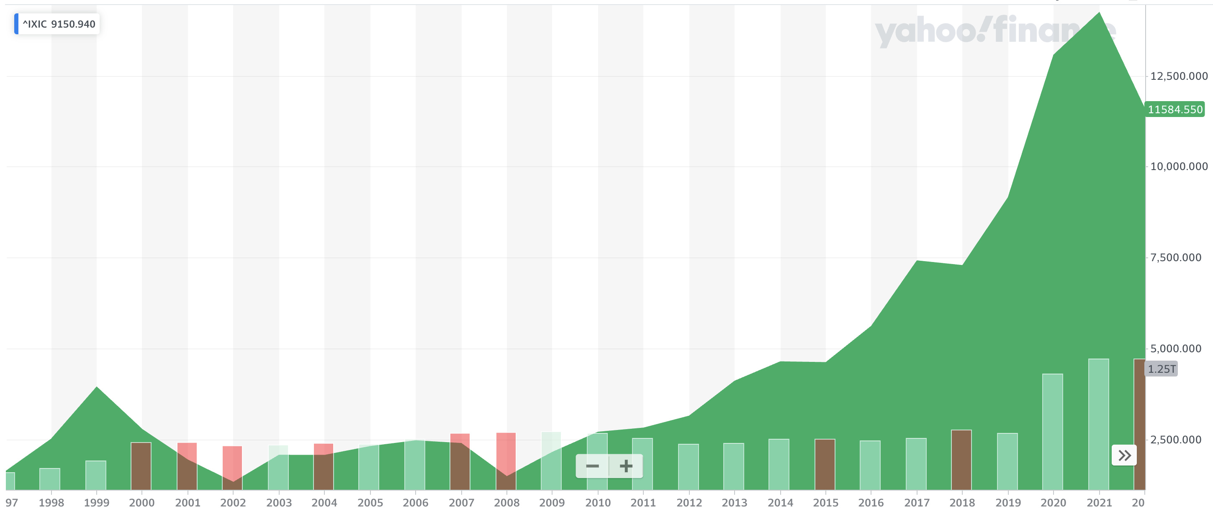
NASDAQ COMPOSITE INDEX
https://finance.yahoo.com/quote/%5EIXIC/

Slide 13
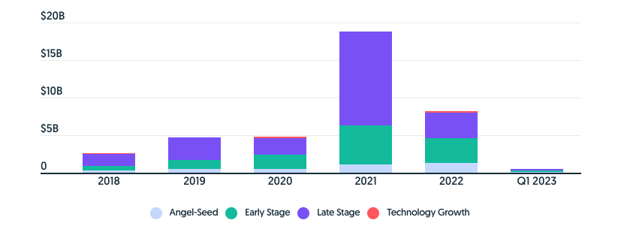
CRUNCHBASE - Latin America’s Startup Funding Continued To Fall Sharply In First Half Of 2023
https://news.crunchbase.com/venture/latin-america-vc-funding-q1-2023/

Slide 14
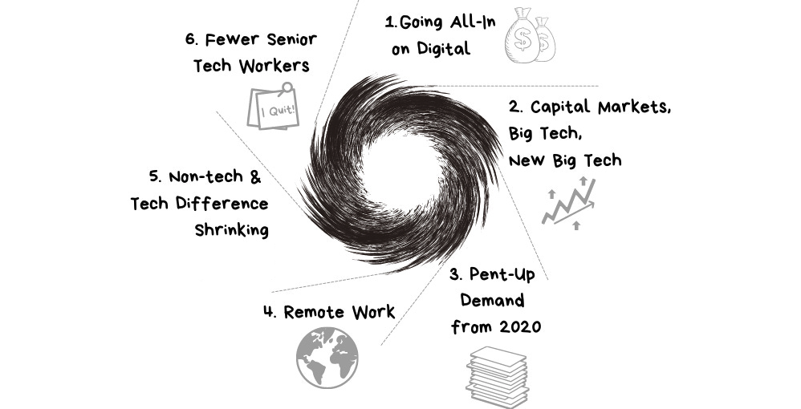
The Pragmatic Engineer - The Perfect Storm Causing an Insane Tech Hiring Market https://newsletter.pragmaticengineer.com/p/perfect-storm-causing-a-hot-tech-hiring-market

Slide 15
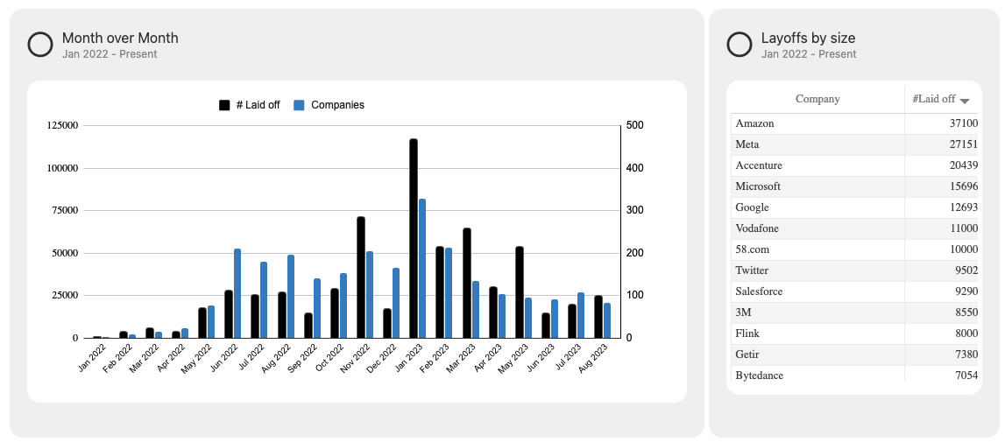
2022 2023 Layoffs - https://layoffs.fyi/

Slide 16
Problem: Economic uncertainty and talent arms race

Slide 17
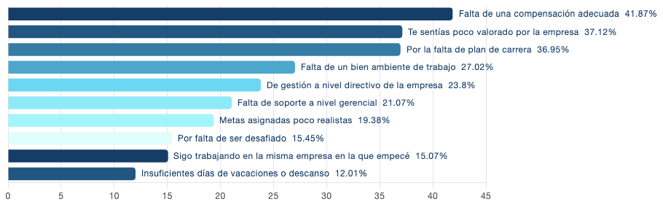
Hireline – Top considerations for changing jobs
https://hireline.io/mx/estudio-mercado-laboral-y-empleos-de-ti-mexico?year=2023#prestaciones-mas-valoradas

Slide 18
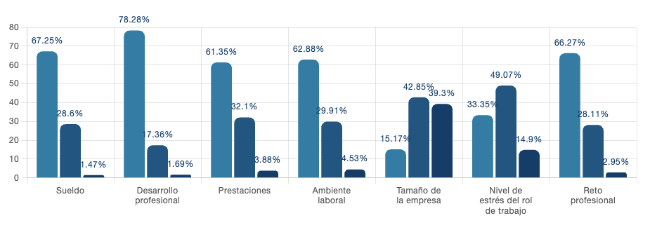
Hireline – Top considerations for changing jobs
https://hireline.io/mx/estudio-mercado-laboral-y-empleos-de-ti-mexico?year=2023#prestaciones-mas-valoradas

Slide 19
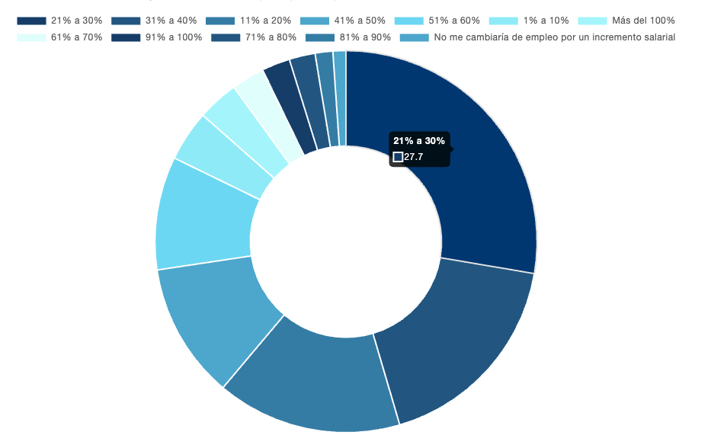
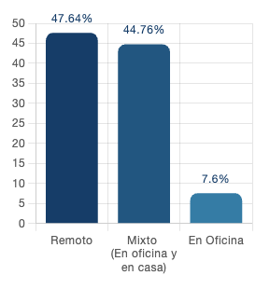
Hireline – Top considerations for changing jobs
https://hireline.io/mx/estudio-mercado-laboral-y-empleos-de-ti-mexico?year=2023#prestaciones-mas-valoradas

Slide 20
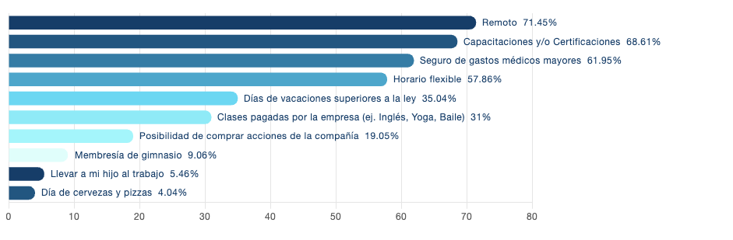
Hireline - Favourite perks
https://hireline.io/mx/estudio-mercado-laboral-y-empleos-de-ti-mexico?year=2023#prestaciones-mas-valoradas

Slide 21
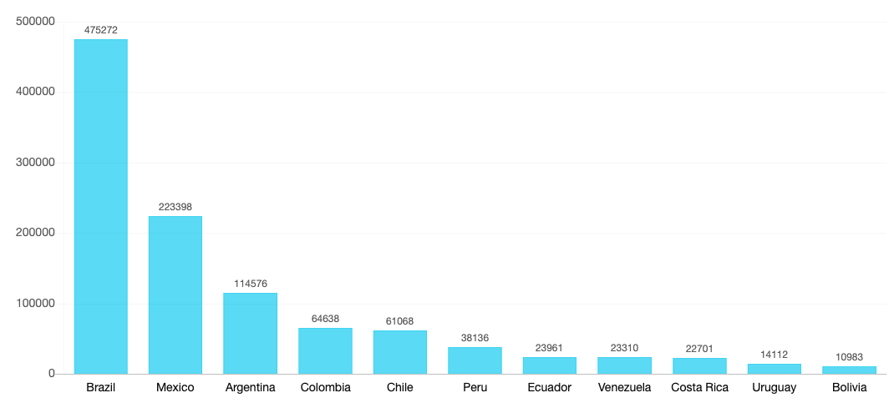
26.9 million developers globally (Evans Data Corporation 2023) It will increase ~1m/year
LATAM is the second highest growth of developers globally
How to identify and attract tech talent from Latin America
https://hireline.io/us/latam-developers-recruitment-guide

Slide 22
Tips for C-Levels, VPs, Directors
Good:
Define a retention budget
Write a detailed job description
Offer fully Remote or Hybrid
Offer certifications and training
Excelent:
Retention budget over hiring budget
Internal hire over external hire
Talent over specialization or years of experience
Expand and hire in all LATAM
Define a career path

Slide 23
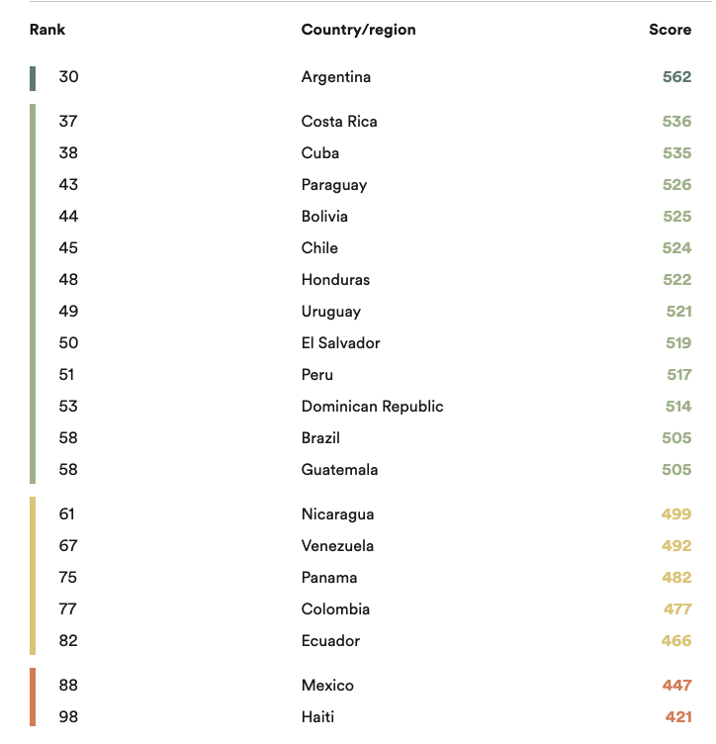
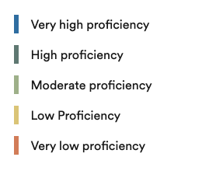
EF – English Proficiency Index by country LATAM Region https://www.ef.com/wwen/epi/

Slide 24
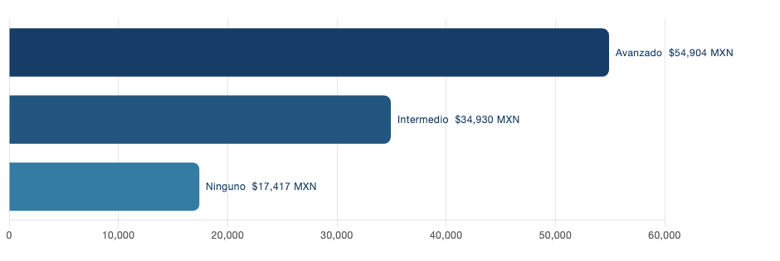
How to identify and attract tech talent from Latin America- https://hireline.io/us/latam-developers-recruitment-guide

Slide 25
Tips for individual contributors
Required:
*All technical roles should be writing code (yes also testers)
Good:
Do not resist to learn new stuff
Trully learn English
Excelent:
Research about the company
Reach out to people who already work there and ask your questions
Have realistic expectations on your compensation

Slide 26
Problem #2

Slide 27
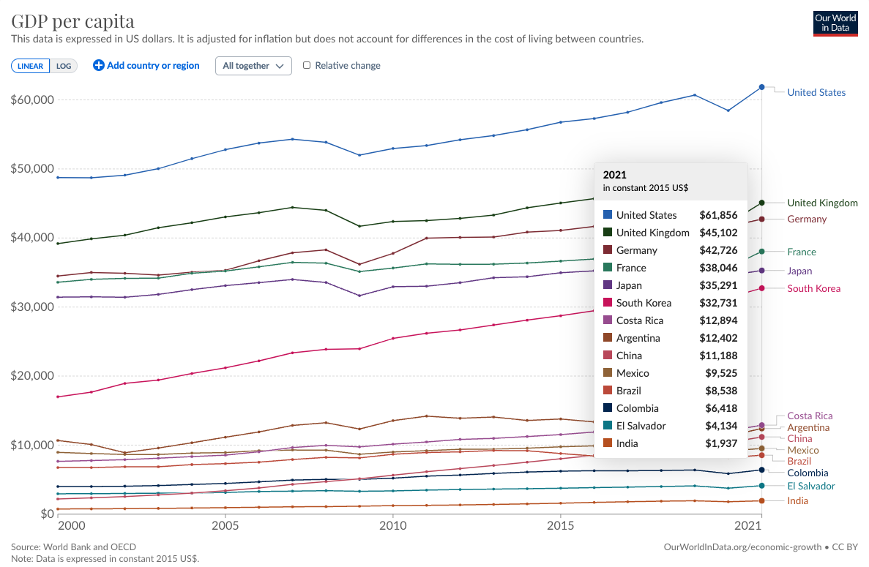
Our World In Data GDP Per Capita - https://ourworldindata.org/grapher/gdp-per-capita-world-bank-constant-usd

Slide 28
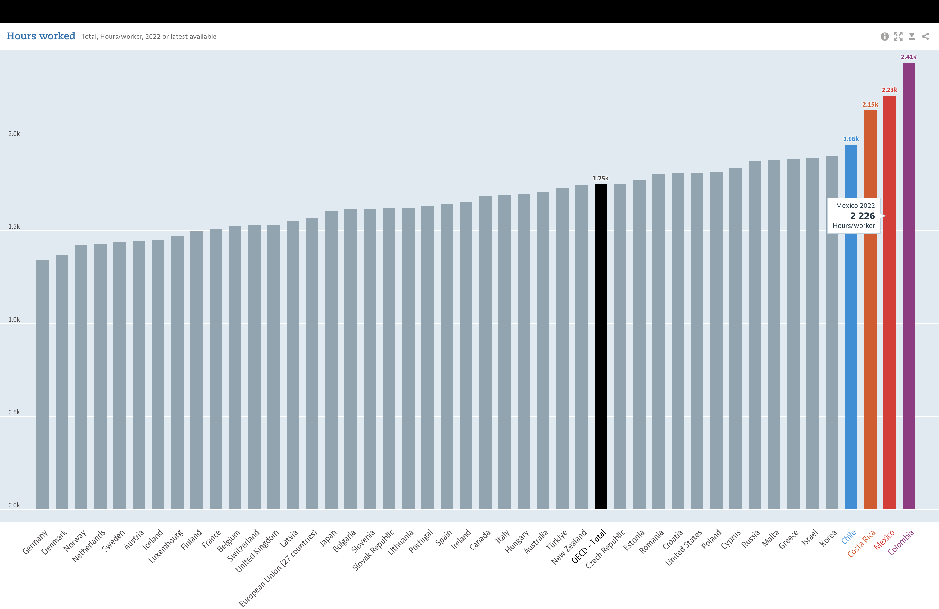
OCDE Hours Worked - https://data.oecd.org/emp/hours-worked.htm

Slide 29
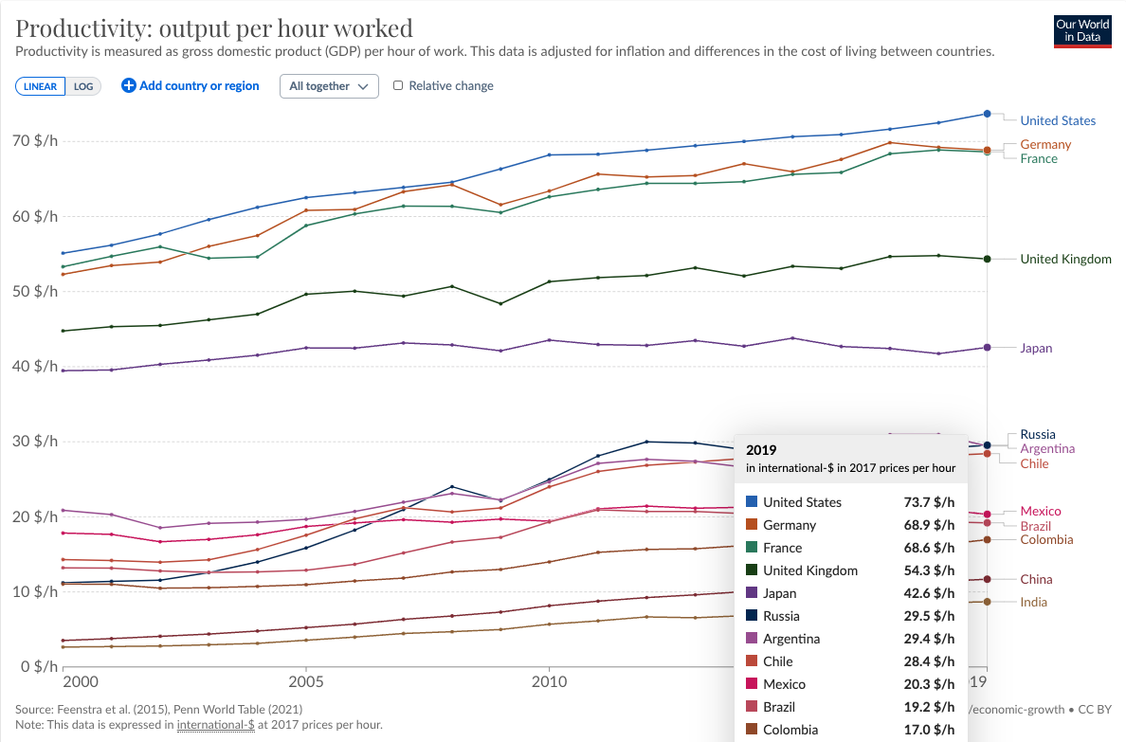
Our World In Data Productivity per hour worked
https://ourworldindata.org/grapher/labor-productivity-per-hour-pennworldtable

Slide 30
Problem: Productivity metrics and the approach to do more are fundamentally wrong

Slide 31
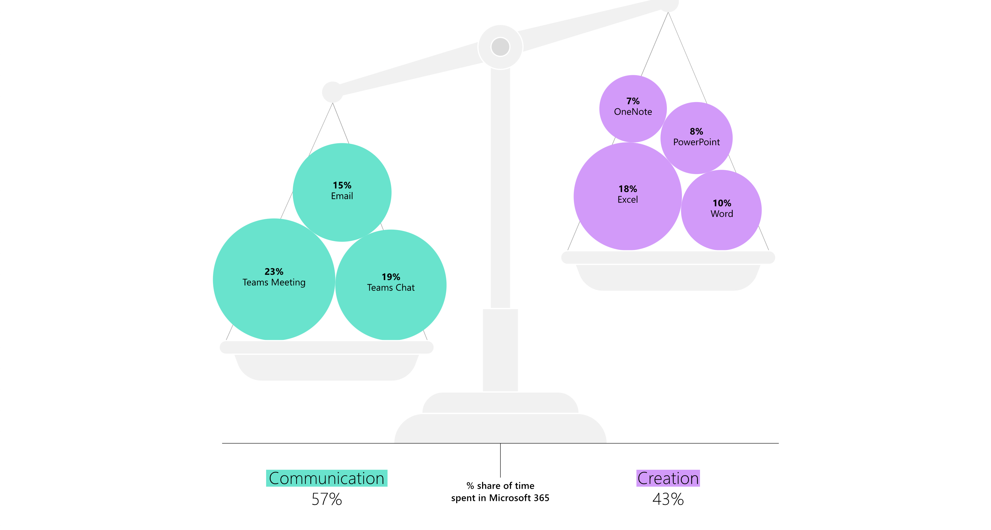
68% of people say
they don’t have enough uninterrupted focus time during the workday
Microsoft – Work trend index Annual Report
https://www.microsoft.com/en-us/worklab/work-trend-index/will-ai-fix-work

Slide 32
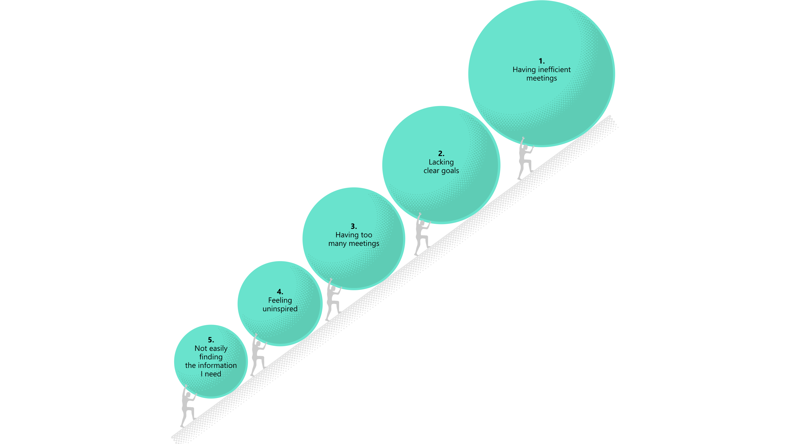
Microsoft – Work trend index Annual Report
https://www.microsoft.com/en-us/worklab/work-trend-index/will-ai-fix-work

Slide 33
Tips for C-Levels, VPs, Directors
Good:
Measure productivity using data and be transparent on the results
Avoid the “always available” approach
Put data and AI to work
KPIs and OKRs
Excelent:
Culture development over program development
Non-interruption/meeting days and lots of async communication
Provide AI tools
You’re killing it
DORA, SPACE or DevEx metrics
4-day week

Slide 34
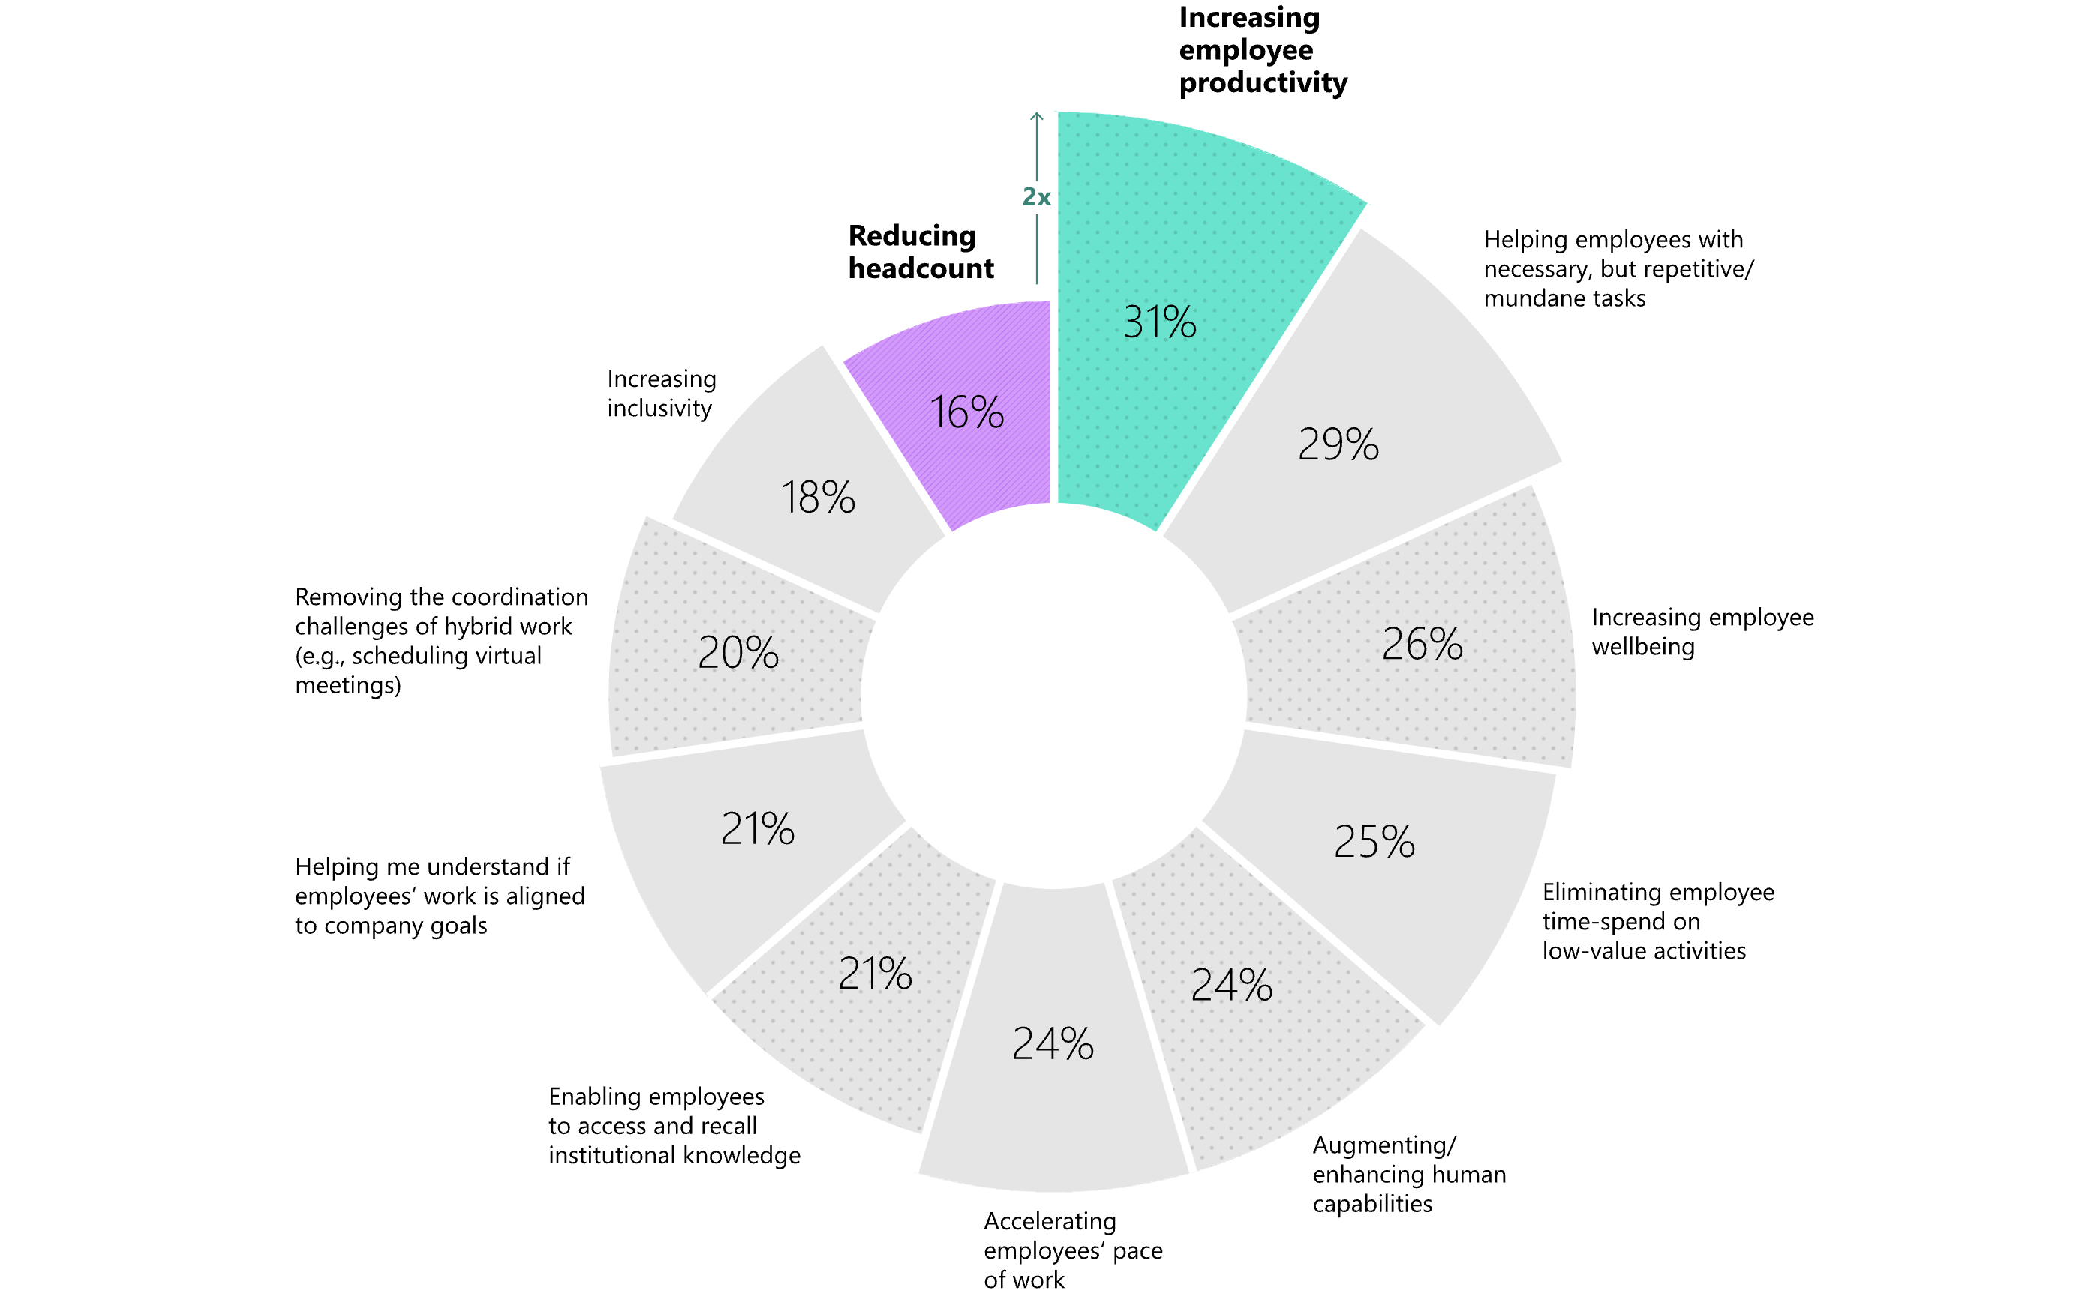
“It’s fascinating that people are more excited about AI rescuing them from burnout than they are worried about it eliminating their jobs.”
- Adam Grant
Microsoft – Work trend index Annual Report
https://www.microsoft.com/en-us/worklab/work-trend-index/will-ai-fix-work

Slide 35
Tips for individual contributors
Good:
Effective time management
Embrace the AI era
Automate as much as you can
Excelent:
Solve your day-to-day problems with AI
Take risks and think of new ways to execute your job

Slide 36
Super Pro Tip:
Be passionate and very intense
to imagine the future and build it

Slide 37
Thank you

Slide 38
Problem #3

Slide 40
Problem: Inequalities

